Slide 1
How to create a REST API in Java using DynamoDB and Serverless
Ref: https://www.serverless.com/blog/how-to-create-a-rest-api-in-java-using-dynamodb-and-serverless

Slide 2
Steps to achieve Goal
Pre-requisites
Creating the REST API service
Deep dive into the Java code
Deploying the service
Calling the API

Slide 3
Install Pre-requisites
Java SDK 8+
Maven
Install the Serverless Framework installed with an AWS account set up.
Install node and npm

Slide 4
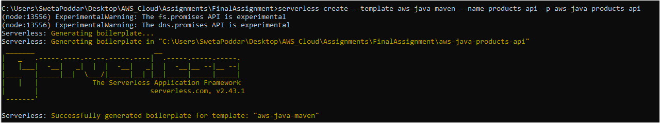
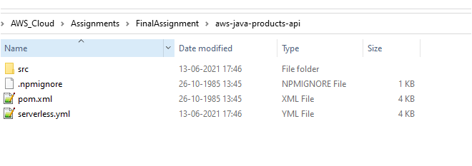
Install Serverless
Run Command
serverless create --template aws-java-maven --name products-api -p aws-java-products-api
This step will create a empty java application package

Slide 5
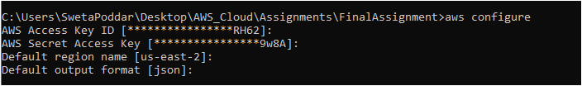
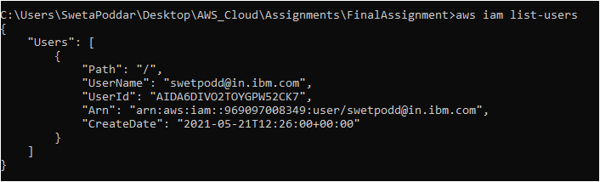
Configure access key
Run Command: To login into AWS Console
aws configure
Run Command:
aws iam list-users

Slide 6
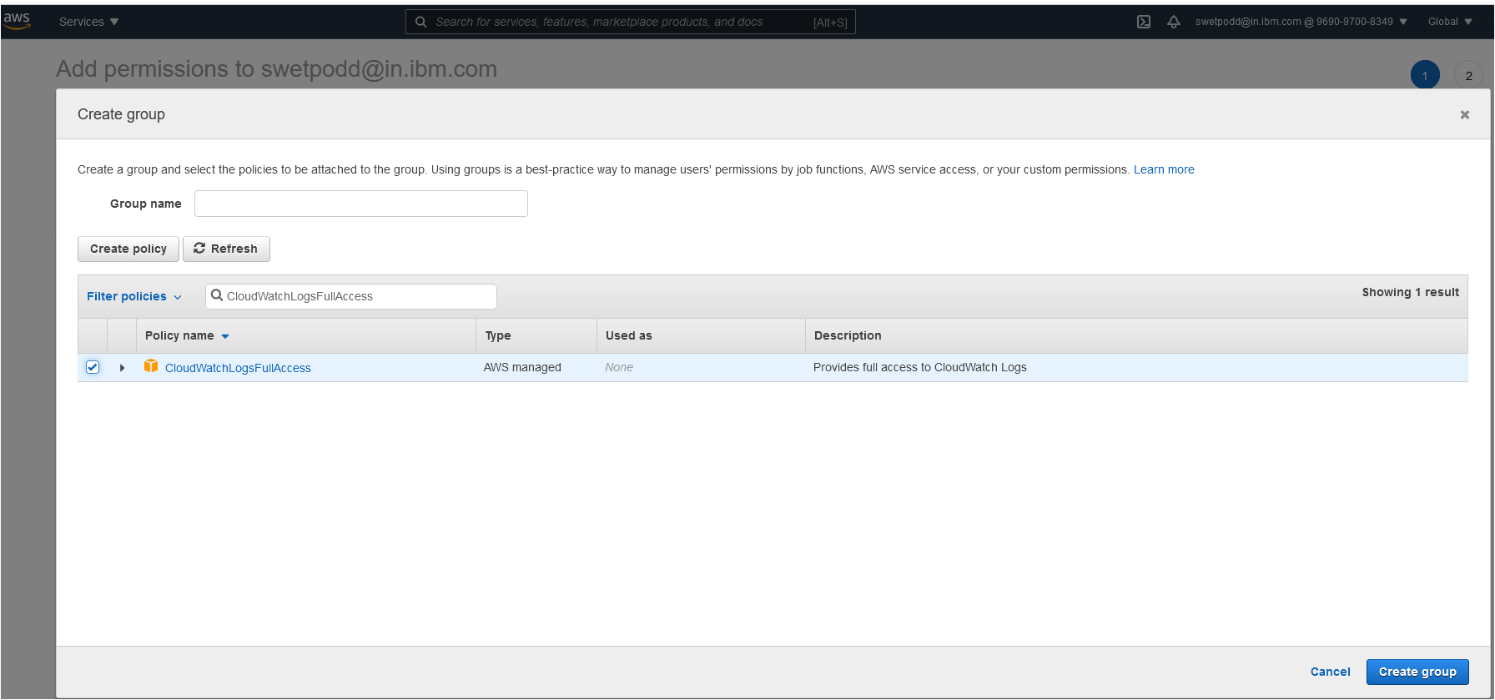
Create Groups
Group Name
SAMAccess

Slide 7
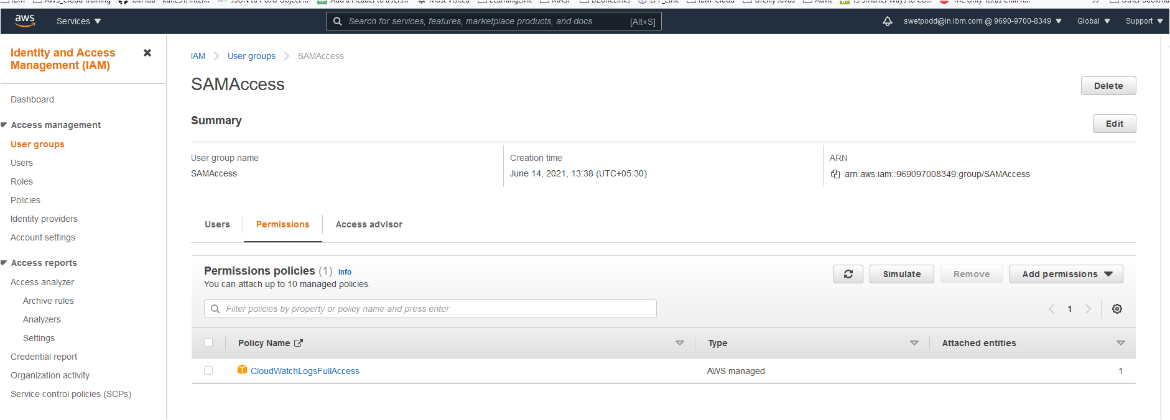
Select & Set Policies
Search for policy
CloudWatchLogsFullAccess
Select the policy and add it to the group

Slide 8
Get the project from Git Hub
https://github.com/rupakg/aws-java-products-api
Fix the compilation issue
Structure the project packaging
Maven Clean Install project

Slide 9
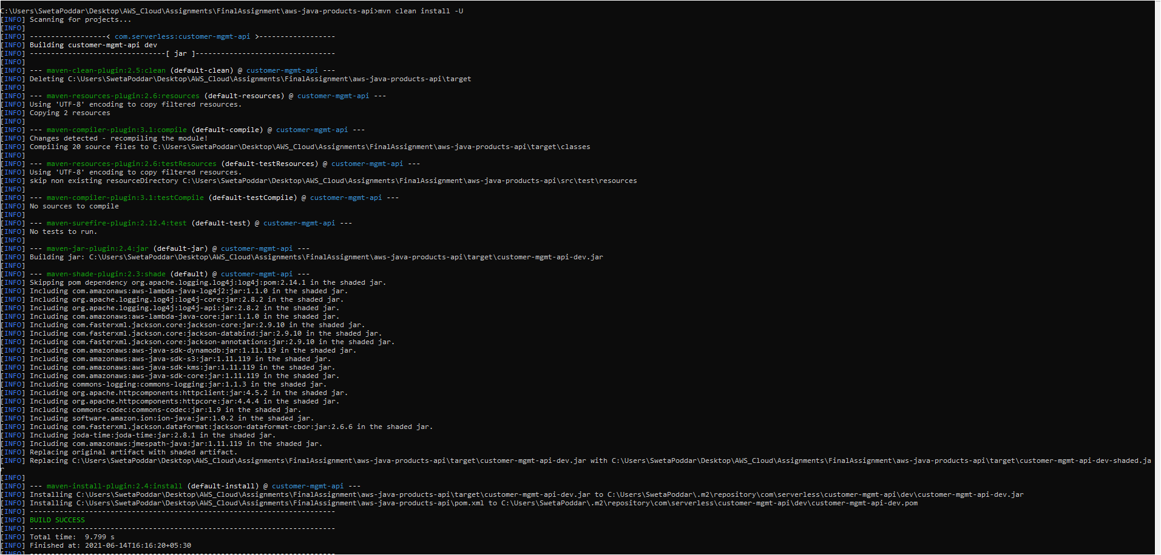

Slide 10

Deploy the serverless.yaml file
Run Command:
Serverless deploy

Slide 11
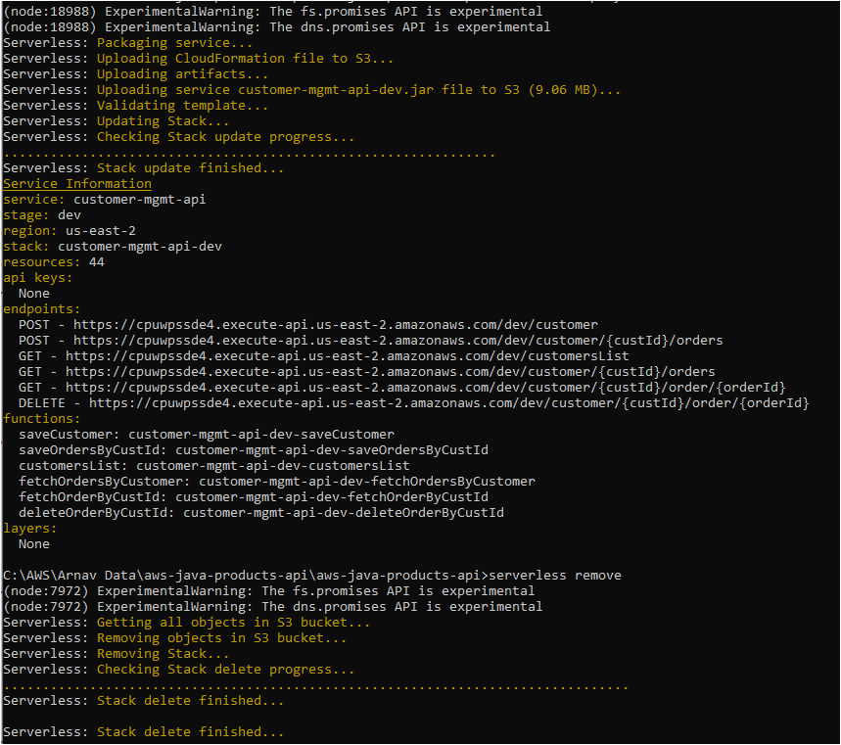

Slide 12
Endpoints of each Operation
POST - https://lcfd48aw7d.execute-api.us-east-2.amazonaws.com/dev/customer
POST - https://lcfd48aw7d.execute-api.us-east-2.amazonaws.com/dev/customer/{custId}/orders
GET - https://lcfd48aw7d.execute-api.us-east-2.amazonaws.com/dev/customersList
GET - https://lcfd48aw7d.execute-api.us-east-2.amazonaws.com/dev/customer/{custId}/orders
GET - https://lcfd48aw7d.execute-api.us-east-2.amazonaws.com/dev/customer/{custId}/order/{orderId}
DELETE - https://lcfd48aw7d.execute-api.us-east-2.amazonaws.com/dev/customer/{custId}/order/{orderId}

Slide 13
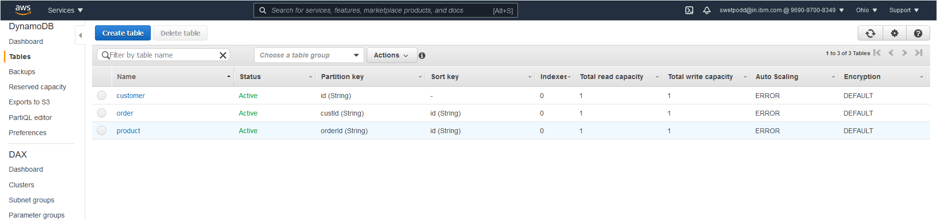
Check if all the three tables created in DynamoDB
Tables
Customer
Order
Product
Customer
Order
Product

Slide 14
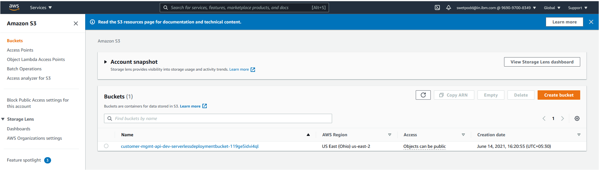
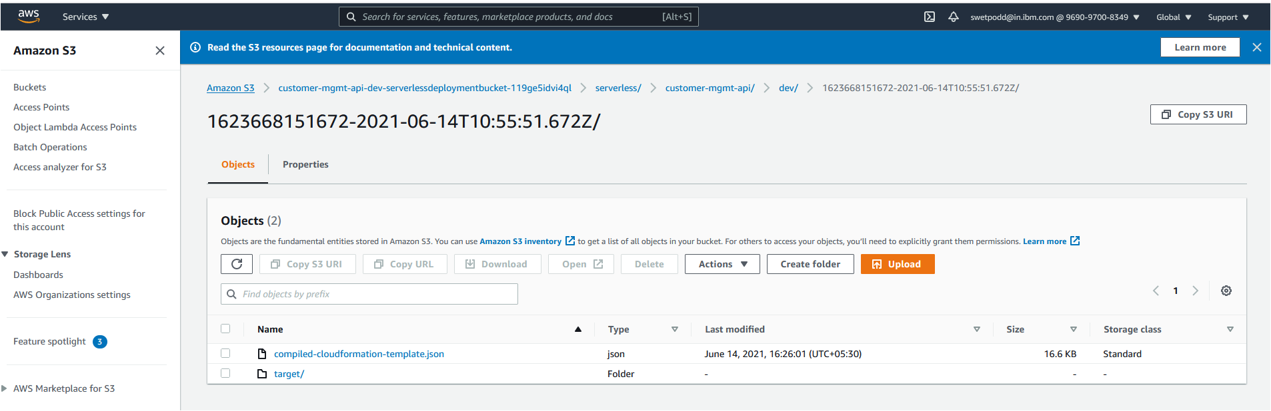
Now Check, S3 Bucket for deployed code

Slide 15
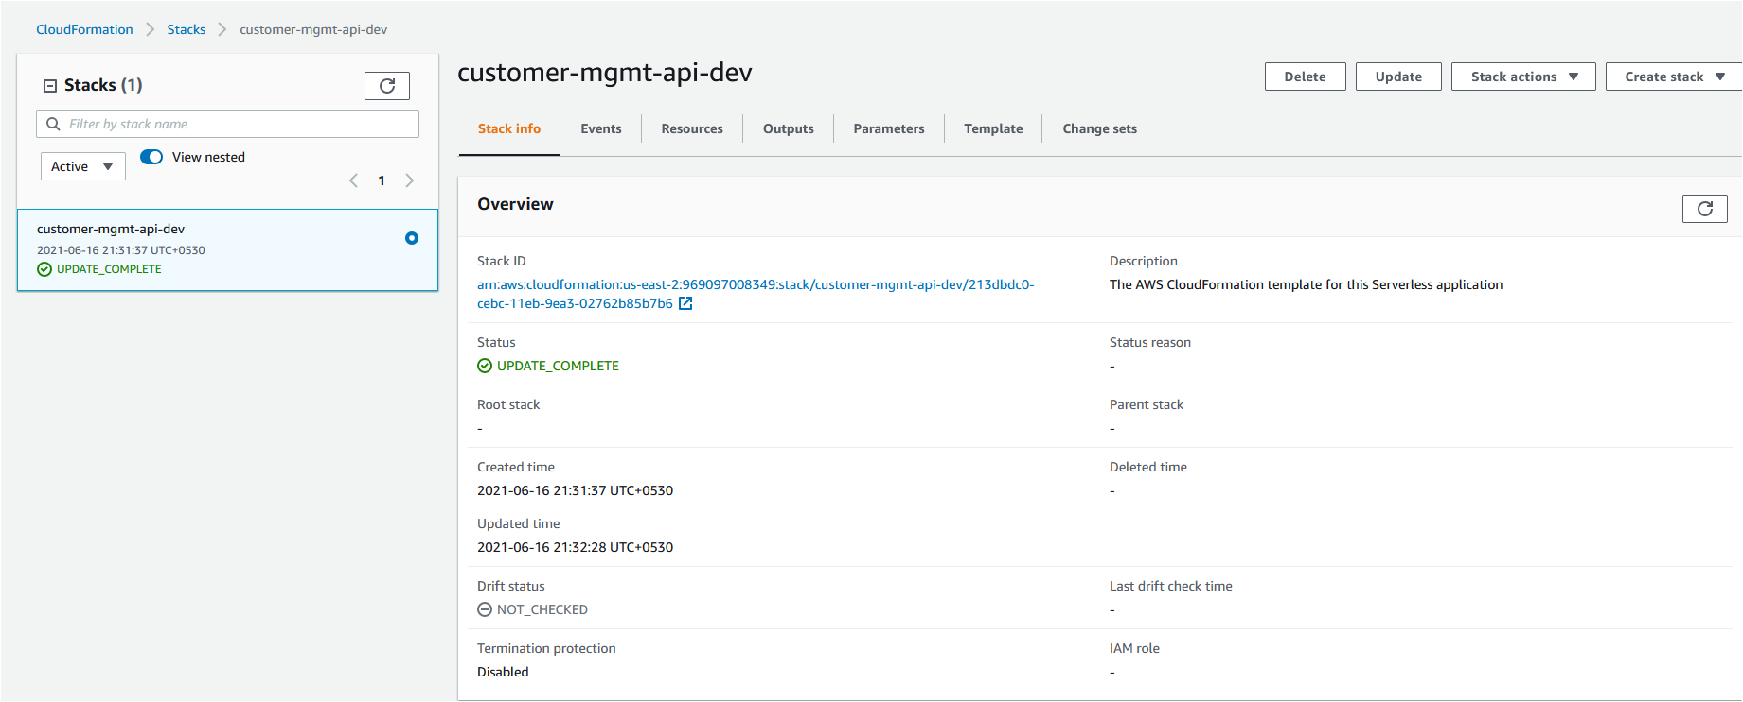
Cloud Formation

Slide 16
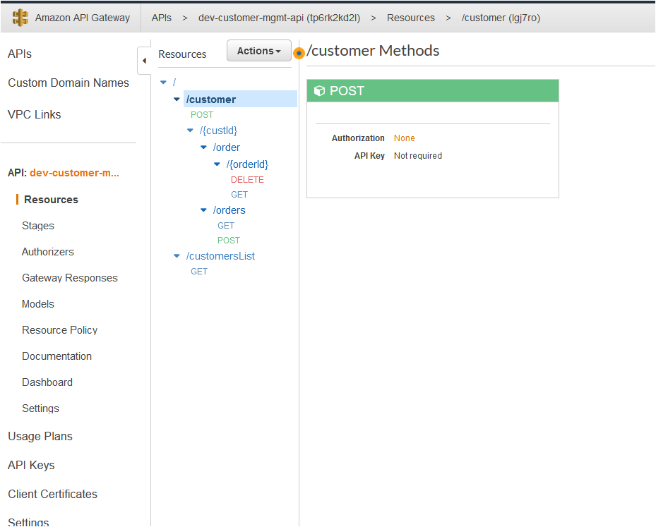
Amazon API Gateway

Slide 17
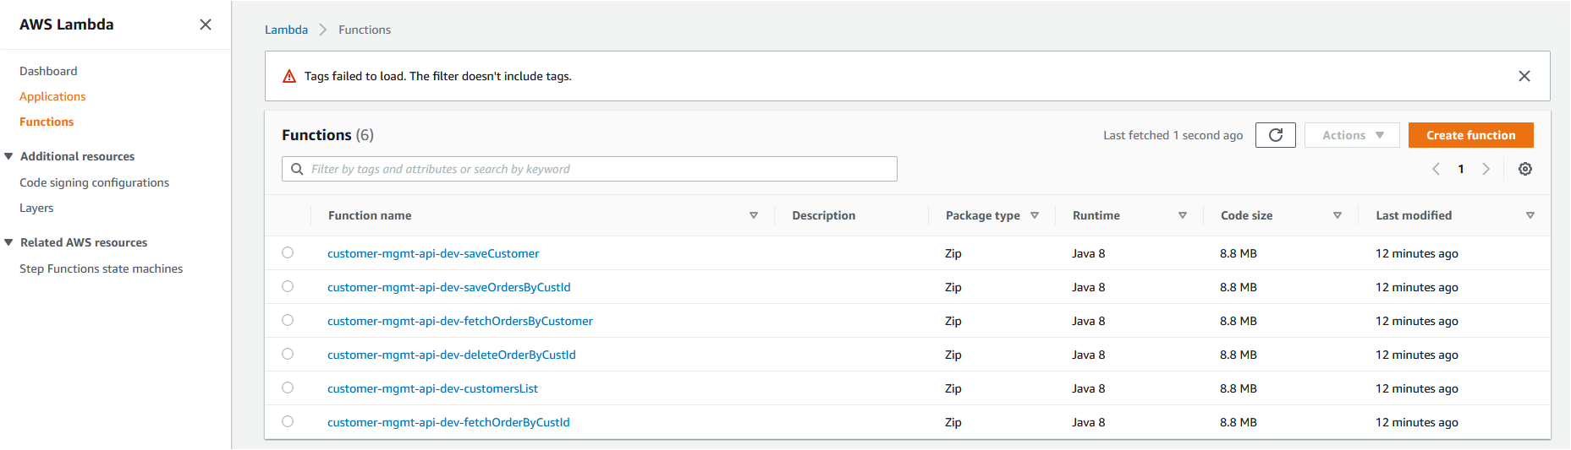
AWS Lambda API List

Slide 18

Run the End Points

Slide 19
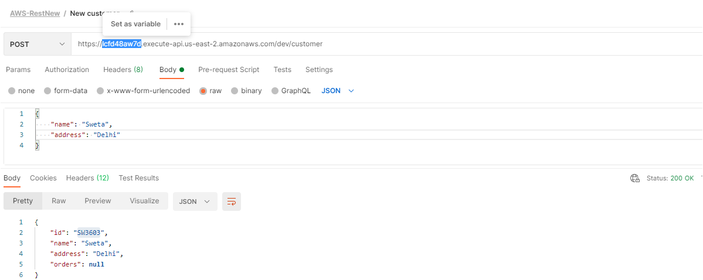
Create Customer
EndPoint
https://lcfd48aw7d.execute-api.us-east-2.amazonaws.com/dev/customer

Slide 20
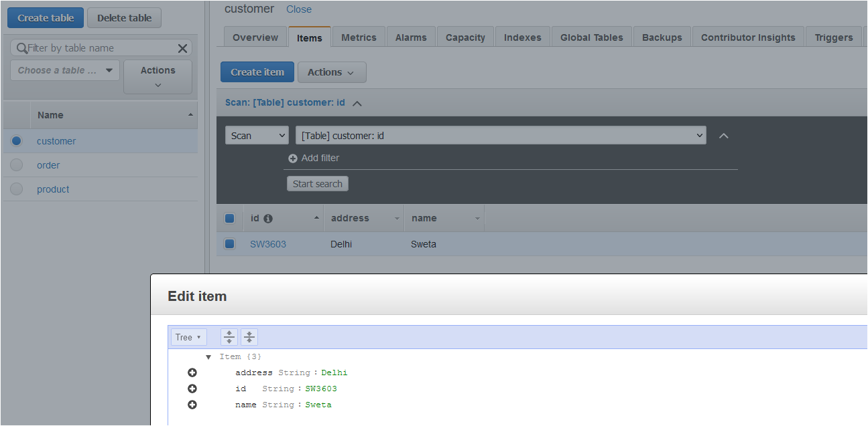
DynamoDB Entry (Customer Table)

Slide 21
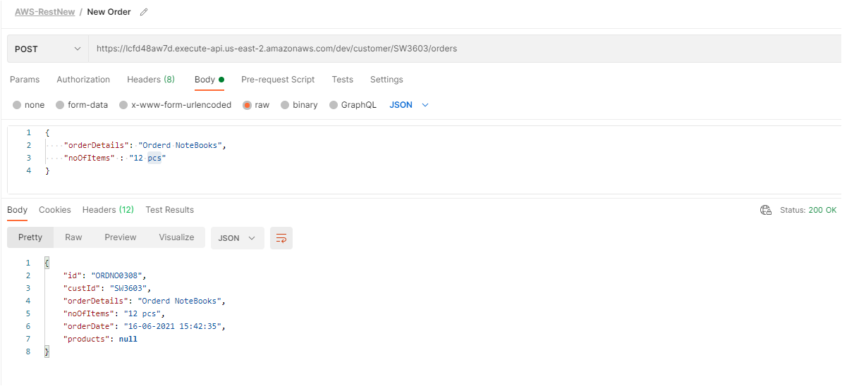
Create Order
EndPoint
https://8sdiwymhi8.execute-api.us-east-2.amazonaws.com/dev/newCustomer

Slide 22
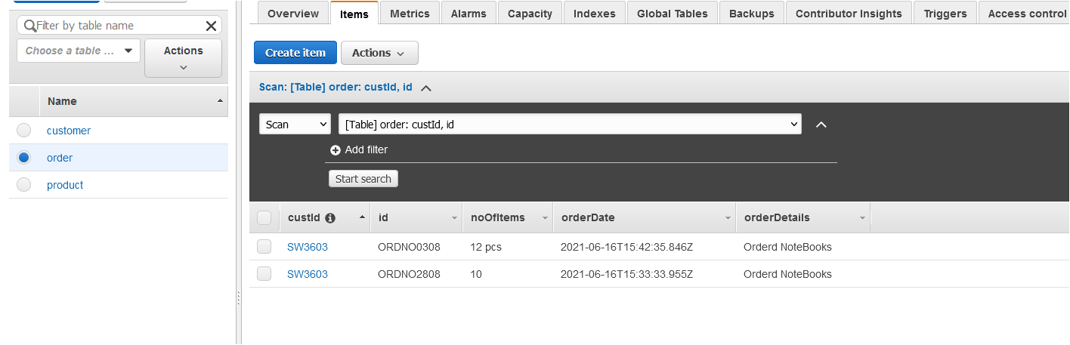
DynamoDB Entry (Order Table)

Slide 23
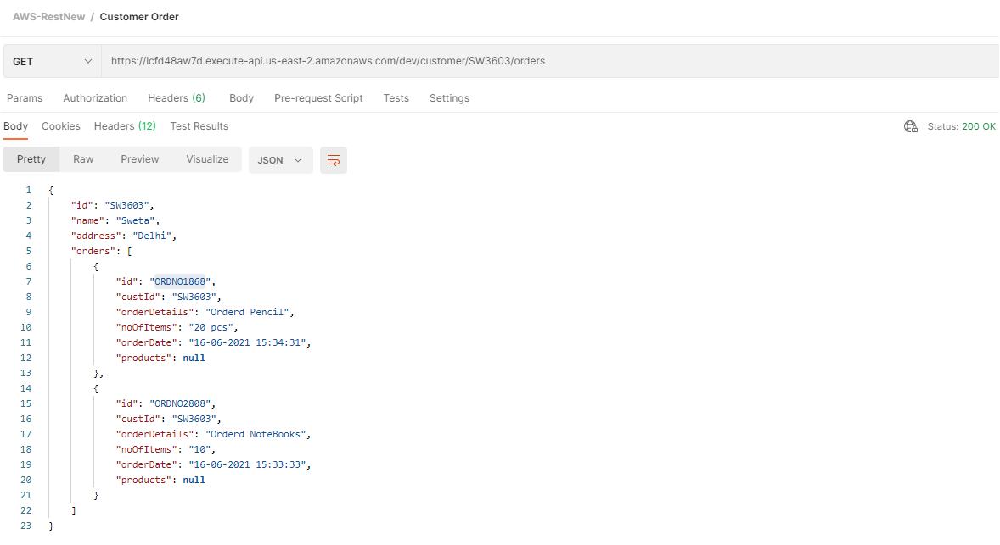
Get Customer’s Orders List
EndPoint
https://lcfd48aw7d.execute-api.us-east-2.amazonaws.com/dev/customer/SW3603/orders

Slide 24
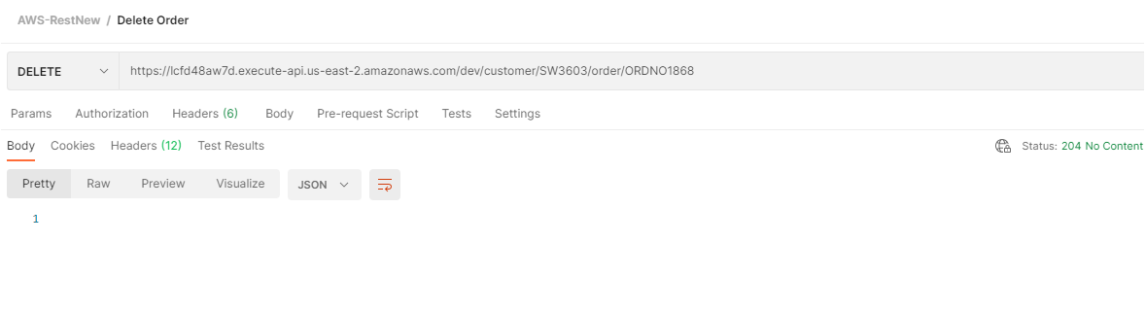
Delete Customer’s Order
EndPoint
https://lcfd48aw7d.execute-api.us-east-2.amazonaws.com/dev/customer/SW3603/order/ORDNO1868

Slide 25
Cloud Watch

Slide 26
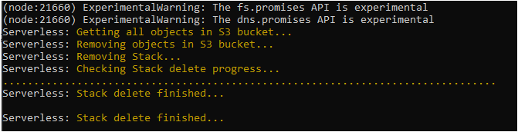
Server Clean-Up
Run Command
serverless deploy

Slide 27
The End
Compiled By,
Sweta Poddar

